Slide 1

FACE MASK DETECTION USING MACHINE LEARNING
-An Approach to Reduce Risk of Corona Virus Spread
Team Members:
Under the Esteemed Guidance of
Dr. Argha Sarkar,
Associate Professor, ECE Department
1.19pa1a04b1 N. AKASH
2.19pa1a04b3 N. DATTA VENU
3.19pa1a0489 L. SAI SUBASH
4.19pa1a0468 K. SUJANA
DEPARTMENT OF ELECTRONICS AND COMMUNICATION ENGINEERING
VISHNU INSTITUTE OF TECHNOLOGY(A), BHIMAVARAM
(Approved by AICTE, Permanently affiliated to JNTUK, Accredited by NBA & NAAC)

Slide 2
CONTENTS
PROBLEM STATEMENT
BLOCK DIAGRAM
RESULTS(obtained as of now)
EXPECTED OUTCOME
PLAN OF ACTION
REFERENCES

Slide 3
PROBLEM STATEMENT
In the present situations, people are not wearing masks in the public places like shopping malls, banks etc.
To overcome this problem, we came up with an idea to use a detector that clicks the pictures of human beings continuously.
It detects from their faces whether they are wearing a mask or not without manual involvement.
This detector is helpful to detect the people faces using image processing and machine learning.

Slide 4
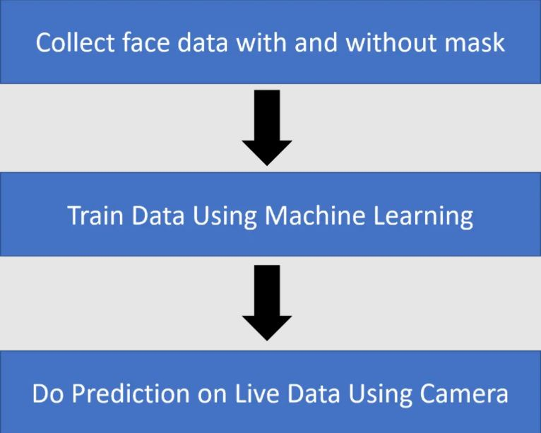
BLOCK DIAGRAM

Slide 5
RESULTS (obtained as of now)
The face mask detector is programmed using python and its libraries like Opencv,Matplotlib etc.
It will be able to detect the faces of human beings using image processing i.e in the opencv library.
This detector can also be able to detect the human faces through the Webcam and gives the output whether they are wearing a face mask or not.

Slide 6
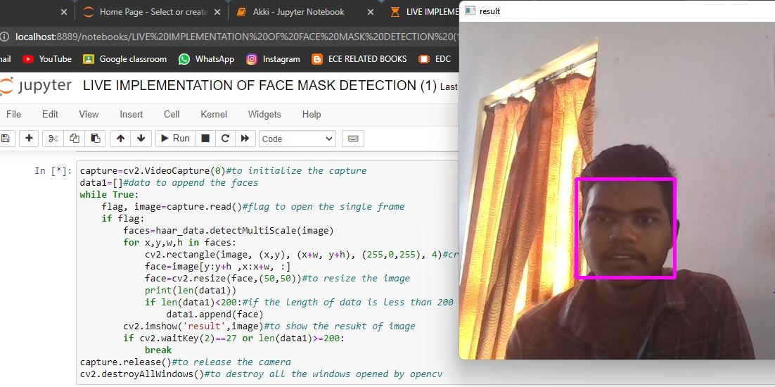
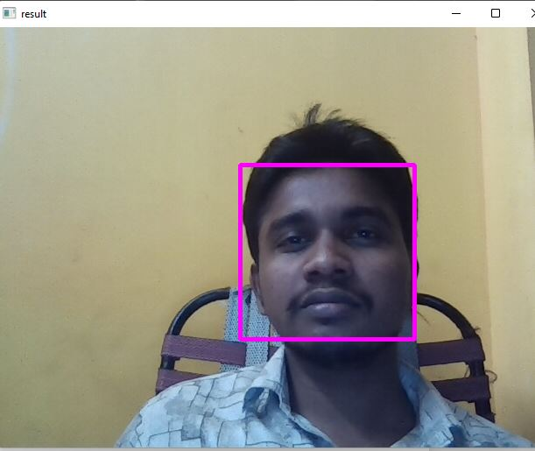
Fig 1:COLLECTING FACES WITHOUT MASK DATASET USING SYSTEM CAMERA

Slide 7
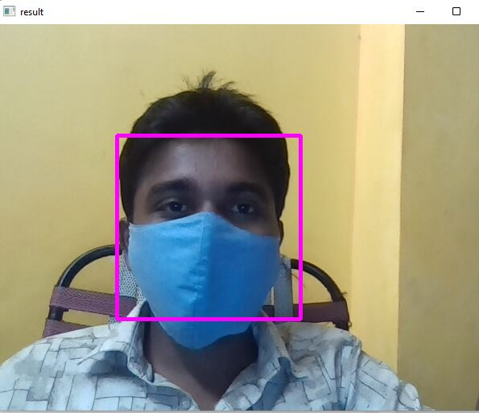
Fig 2 :COLLECTING FACES WITH MASK DATASET USING SYSTEM CAMERA

Slide 8
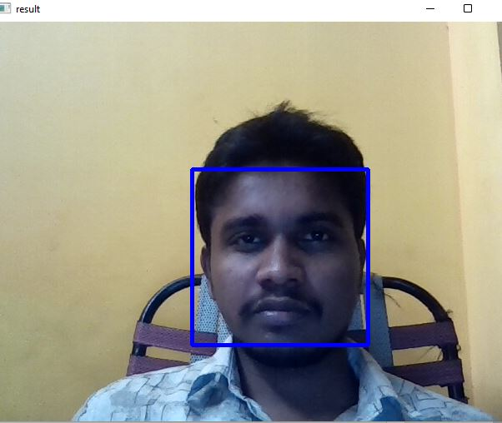
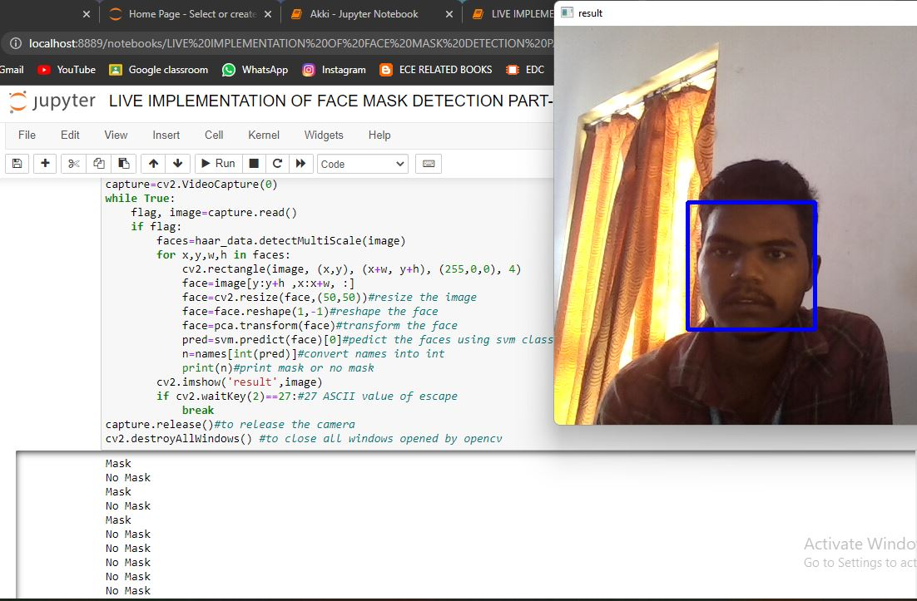

Fig 3:DETECTION OF FACE WITHOUT MASK USING SYSTEM CAMERA

Slide 9
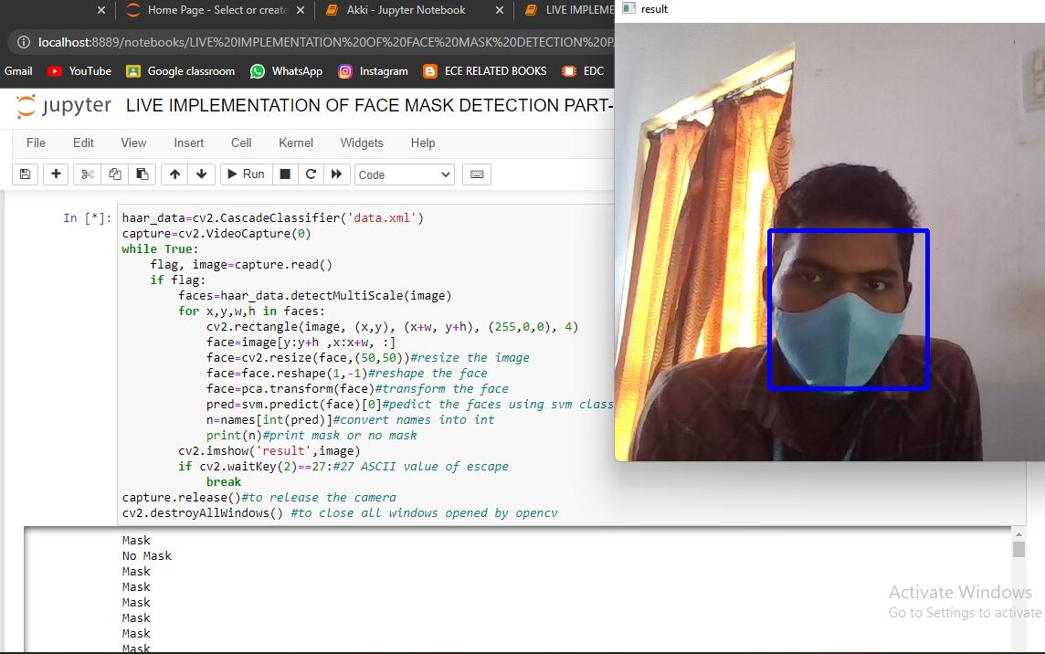
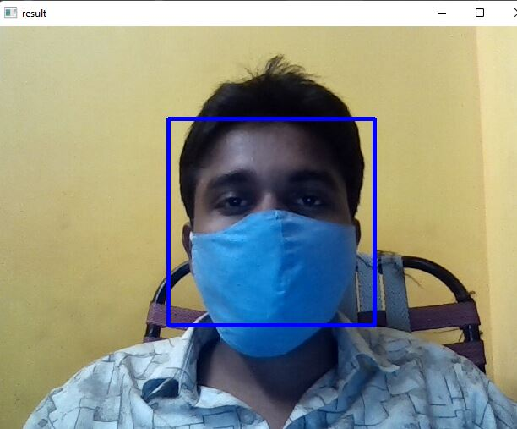
Fig 4:DETECTION OF FACE WITH MASK USING SYSTEM CAMERA

Slide 10
EXPECTED OUTCOME
This model will be able to detect the face with or without mask with better accuracy.
The output will be shown on the frame .
This model can be implemented using outer devices like web cams e.t.c.

Slide 11
PLAN OF ACTION
1.DATA COLLECTION 1 WEEK
2. MODEL BUILDING 2 WEEKS
3.MODEL TESTING 1 WEEK
4.FINAL RESULTS 1 WEEK
5.REPORT SUBMISSION

Slide 12
REFERENCES
Das, Arjya, Mohammad Wasif Ansari, and Rohini Basak. "Covid-19 Face Mask Detection Using TensorFlow, Keras and OpenCV." 2020 IEEE 17th India Council International Conference (INDICON). IEEE, 2020.
"Feature extraction based on deep learning for some traditional machine learning methods." 2018 3rd International Conference on Computer Science and Engineering (UBMK). IEEE, 2018.
Loey, Mohamed, et al. "A hybrid deep transfer learning model with machine learning methods for face mask detection in the era of the COVID-19 pandemic." Measurement 167 (2021): 108288.
Adusumalli, Harish, et al. "Face Mask Detection Using OpenCV." 2021 Third International Conference on Intelligent Communication Technologies and Virtual Mobile Networks (ICICV). IEEE, 2021.

Slide 13
THANK YOU

